Slide 1
www.health.gov.lk
See your health care. One step at a time.

Slide 2
How to use
Preview version of the website may function normal as a website within the keynote preview, navigate the site as required.
Prototype will include prefilled fields and static data to make the experience more comfortable for you.

Slide 3
Loading
Loading…

Slide 4
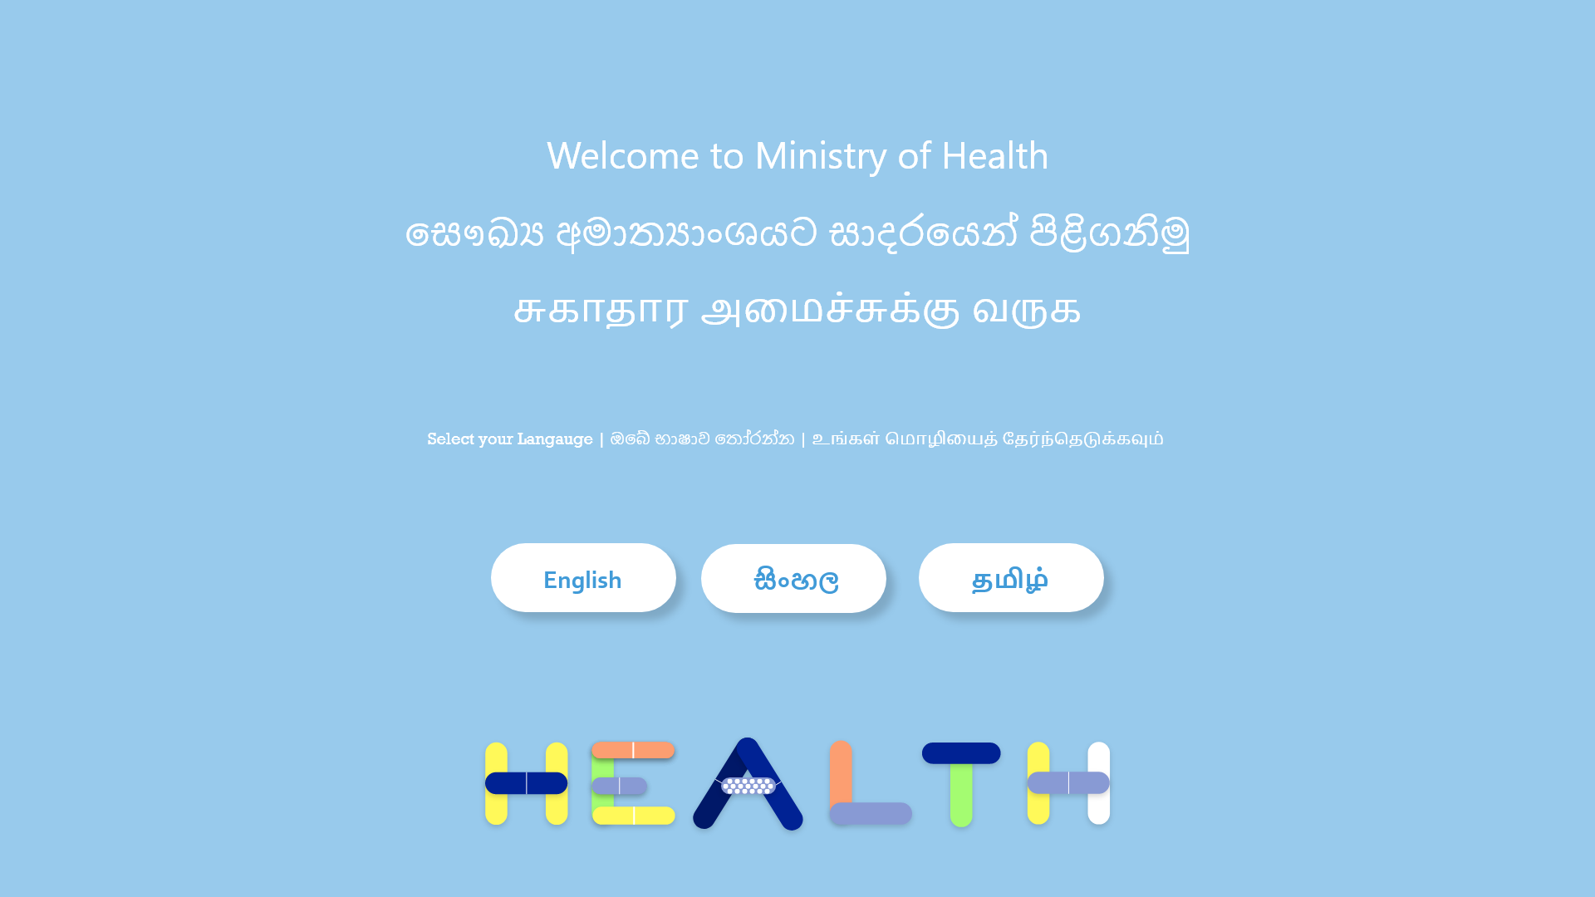

Slide 5

Home - English

Slide 6
Home - English

Slide 7
Home - English

Slide 8
Home - English

Slide 9
Home - English

Slide 10
Home - English

Slide 11
Home - English

Slide 12
Home - English

Slide 13
Home - English

Slide 14
Home - English

Slide 15
Home - English

Slide 16
Home - English

